Slide 1
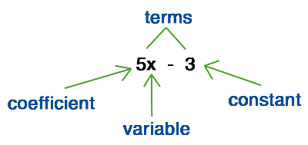
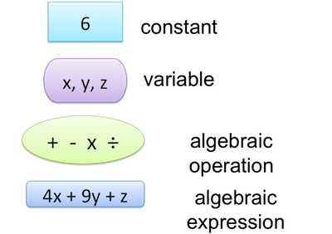
My Algebra Interactive Notebook
Name
Class
Teacher Mr Evans
Term 2 Semester 1
1

Slide 2
Contents
Glossary or Formula Page
Page
Date
Description
2
3

Slide 3
Tasks
24
7
30
Essential Question
Questions
Notes
Summary

Slide 4
24
7
30
Date
Rearranging Equations
EQ – What are the key rules to rearranging equations?
Making a parameter the subject of an equation is carried out by simply applying the rules of arithmetic.
“To keep both sides of an equation equal what ever you do to one side you MUST do to the other whether it is addition , subtraction, multiplication or division. "
“If you are multiplying or dividing you must do it to EVERY TERM in the equation not just some terms.”
AND

Slide 5
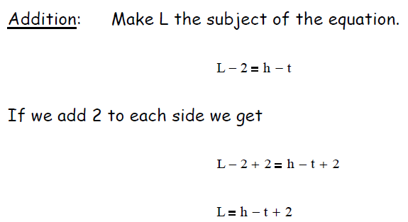
24
7
30
Date
Rearranging Equations
EQ – What are the key rules to rearranging equations?
Making a parameter the subject of an equation is carried out by simply applying the rules of arithmetic.
“To keep both sides of an equation equal what ever you do to one side you MUST do to the other whether it is addition , subtraction, multiplication or division. "
“If you are multiplying or dividing you must do it to EVERY TERM in the equation not just some terms.”
AND

Slide 6
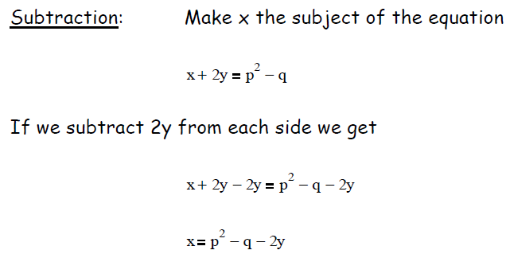
24
7
30
Date
Rearranging Equations
EQ – What are the key rules to rearranging equations?

Slide 7
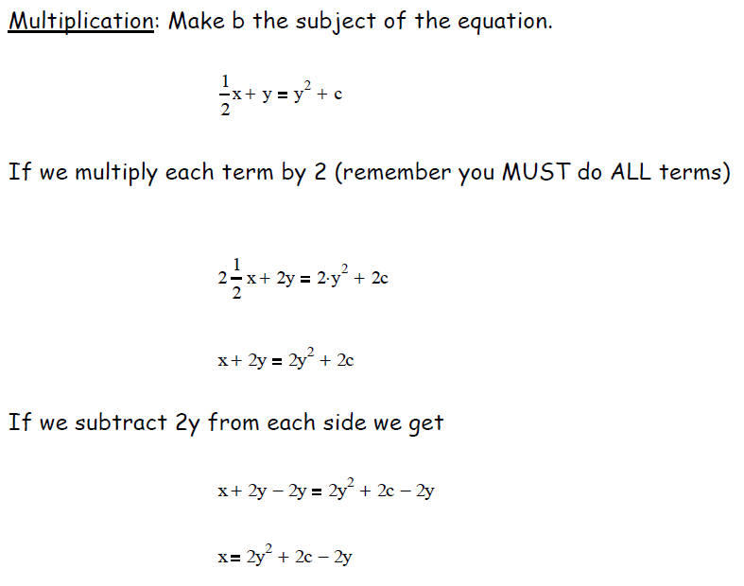
24
7
30
Date
Rearranging Equations
EQ – What are the key rules to rearranging equations?

Slide 8
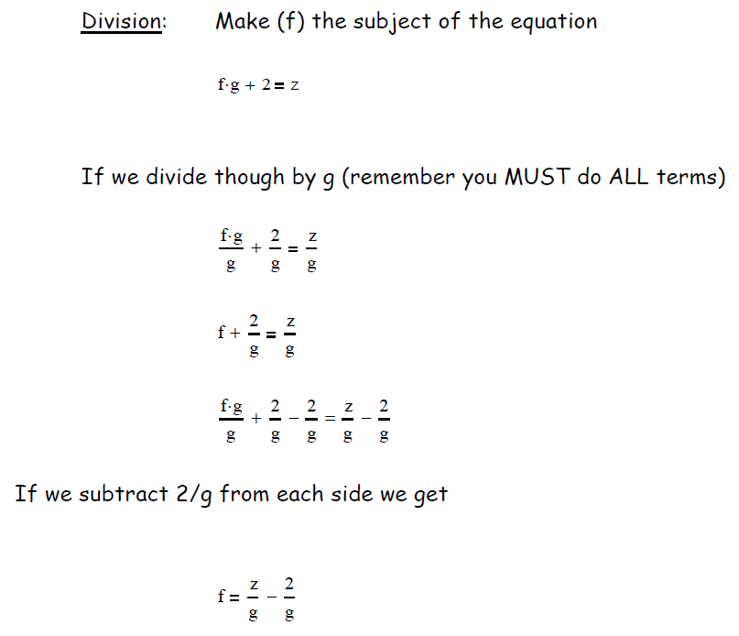
24
7
30
Date
Rearranging Equations
EQ – What are the key rules to rearranging equations?

Slide 9
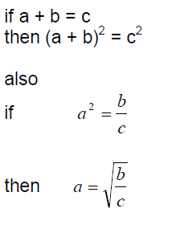
24
7
30
Date
Rearranging Equations
EQ – What are the key rules to rearranging equations?
square or square root both sides

Slide 10
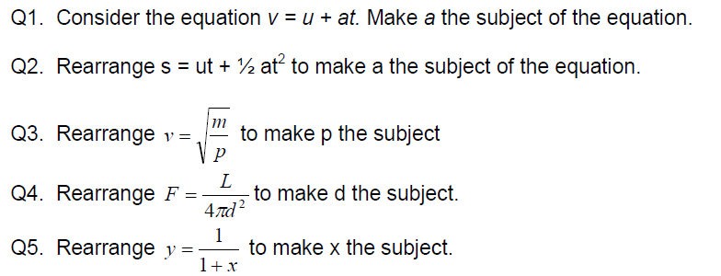
Task

Slide 11
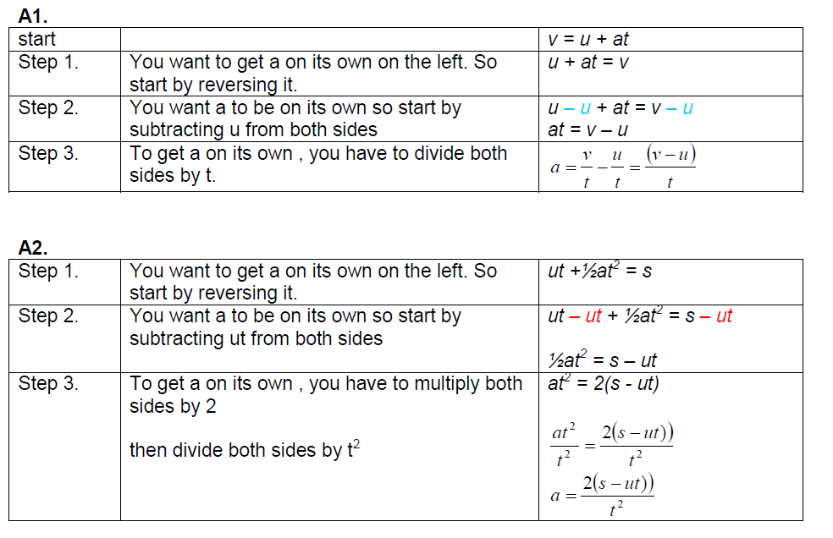
Answers

Slide 12
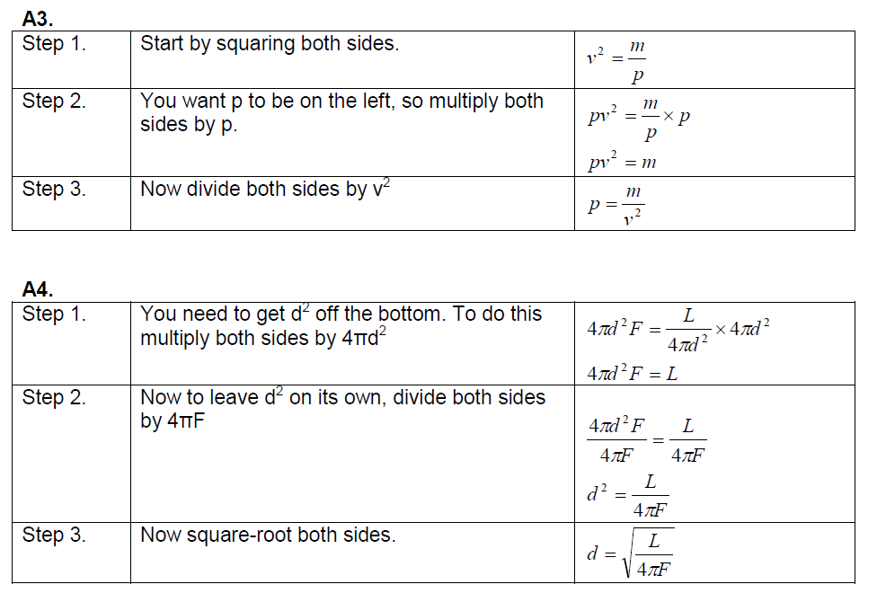
Answers

Slide 13
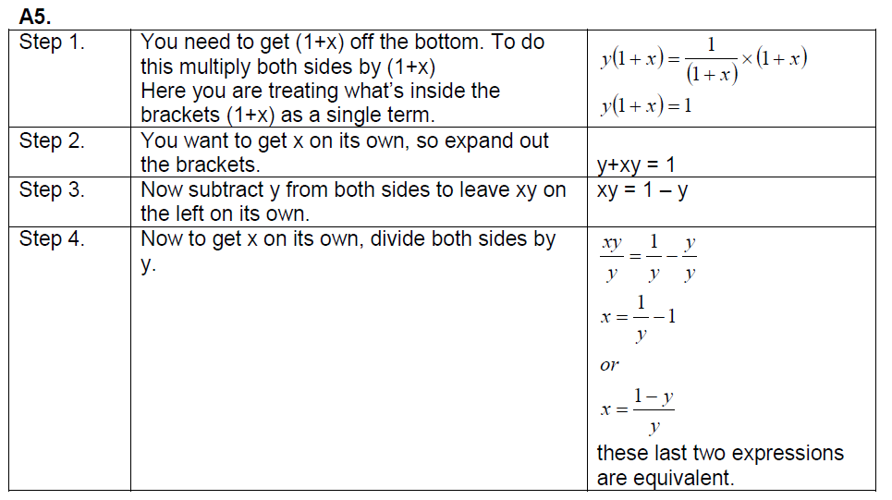
Answers

Slide 14
Notes Review
24, 7 ,30
Date
Title
Essential question
Notes complete
Notes complete with colour and diagrams
Questions completed
Contents page filed in
Formula page filled in

Slide 15
Homework
Review your notes and write a summary answering the essential question.

